Slide 1
MSc Artificial Intelligence
Knowledge Engineering
15 November 2023
Notes:
This colour bar is to be used for Artificial Intelligence

Slide 2
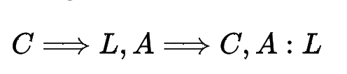
A Problem with Propositions
All computer scientists are logical
Alan is a computer scientist
Therefore Alan is logical
We can represent this easily this in propositional logic
What about another computer scientist, Grace?
Our argument above is about Alan.
We need to construct another argument for Grace.
What about Physicists, Philophers, Classicists?
This seems……wasteful

Slide 3
First Order Logic
Even worse….
All men are mortal
Socrates is a man
Therefore Socrates is mortal
Do our tools allow us to prove that this is a valid argument?
These are all propositions, but they use quantifiers (all, some)
No tools for working for this in propositional logic.
Careful definitions of the sentences has got us out of trouble so far but won’t work here.
We need some new mechanisms.

Slide 4
First Order Logic
Propositions have to be unconditionally True or False
All men are mortal
Socrates is a man
It always rains in Belfast
First order logic introduces mechanisms that allow us to include and reason about
Variables (Men, Socrates, Belfast etc)
Quantifiers (all, some)
Predicates (is mortal, is a man, it rains)

Slide 5
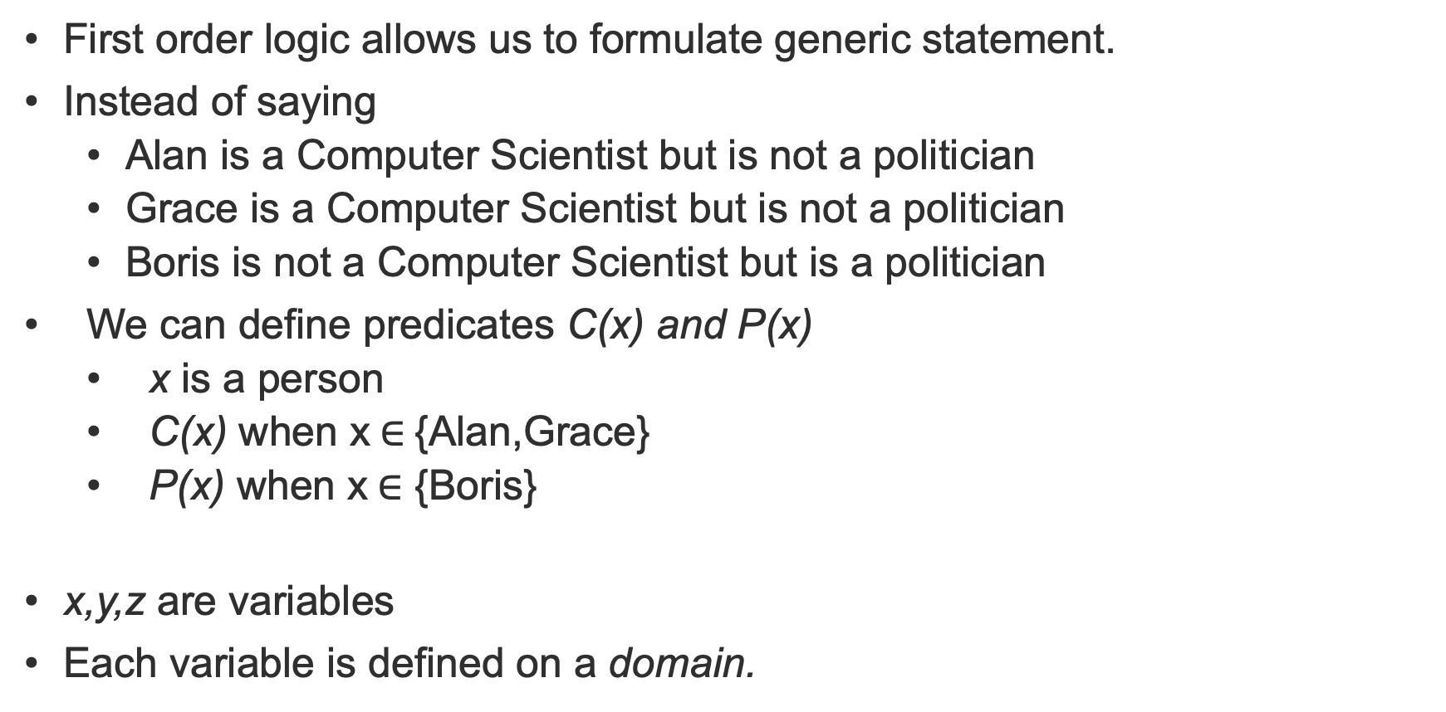
Variables and Predicates
First order logic allows us to formulate generic statement.
Instead of saying
Alan is a Computer Scientist but is not a politician
Grace is a Computer Scientist but is not a politician
Boris is not a Computer Scientist but is a politician
We can define predicates C(x) and P(x)
x is a person
C(x) when x$∈${Alan,Grace}
P(x) when x$∈$ {Boris}
x,y,z are variables
Each variable is defined on a domain.

Slide 6
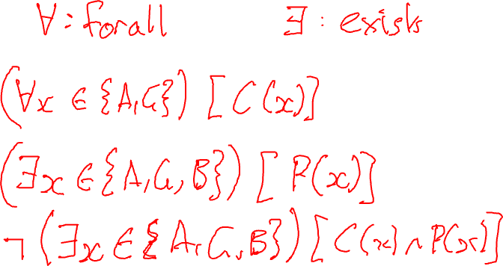
Quantifiers
We may wish to make statements about part or all of a variable domain
Notes:
Exists, forall {Alan, Grace, Boris) C(x), P(x)

Slide 7
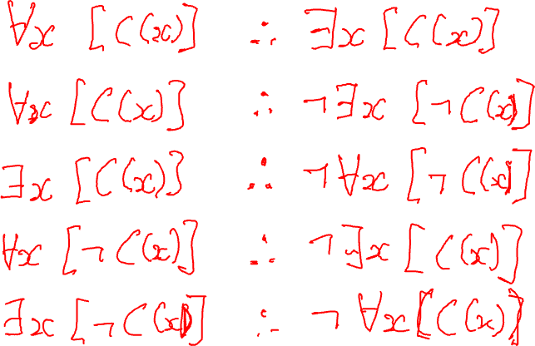
Duality of Quantifiers
Notes:
Consider the following two pairs of statements:
> $\forall\ x\ [C(x)]\quad\iff\quad\lnot\exists\ x\ [\lnot C(x)]$
and
> $\exists\ x\ [C(x)]\quad\iff\quad\lnot\forall\ x\ [\lnot C(x)]$
Are these statements True?
What about the following statements?
> $\forall\ x\ [\lnot C(x)]\quad\iff\quad\lnot\exists\ x\ [C(x)]$
and
> $\exists\ x\ [\lnot C(x)]\quad\iff\quad\lnot\forall\ x\ [C(x)]$ The quantifiers $\forall$ and $\exists$ are said to be **dual** to each other.

Slide 8
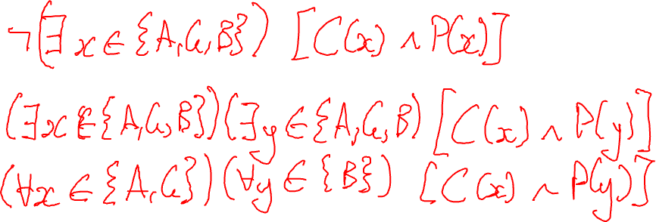
Logical Connectives
We can use connectives with both predicates and quantifiers
Notes:
Alan and Grace C(x) and not P(x)
Boris P(x) and not C(x)
No x in {A,G,B) such that P^C

Slide 9
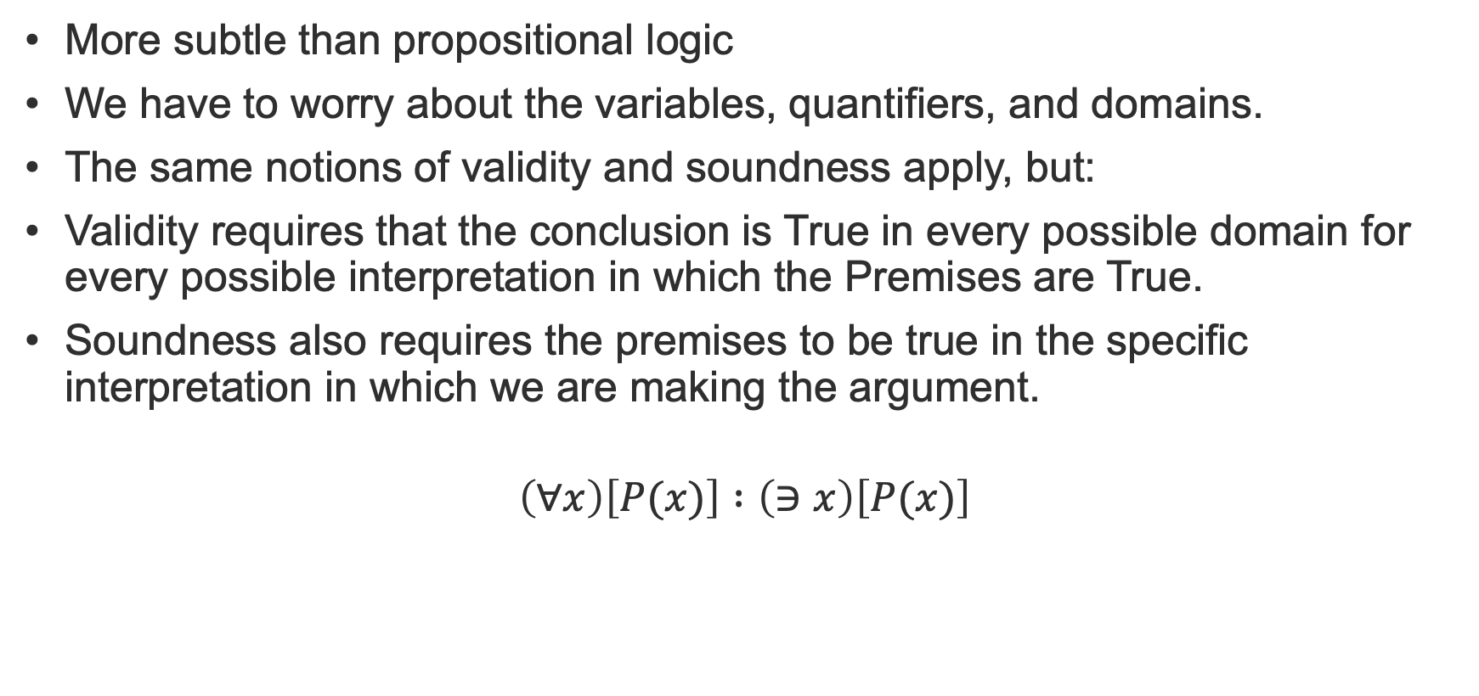
Arguments in First Order Logic
More subtle than propositional logic
We have to worry about the variables, quantifiers, and domains.
The same notions of validity and soundness apply, but:
Validity requires that the conclusion is True in every possible domain for every possible interpretation in which the Premises are True.
Soundness also requires the premises to be true in the specific interpretation in which we are making the argument.
$$\left(∀x\right)\left[P(x)\right] :\left(∋x\right)\left[P(x)\right]$$
Notes:
Argument shown is valid. It is sound if x is bicycles and P is “has two wheels”. It is not sound if P is has two wheels and x is birds, because the premise forall x P(x) is False.

Slide 10
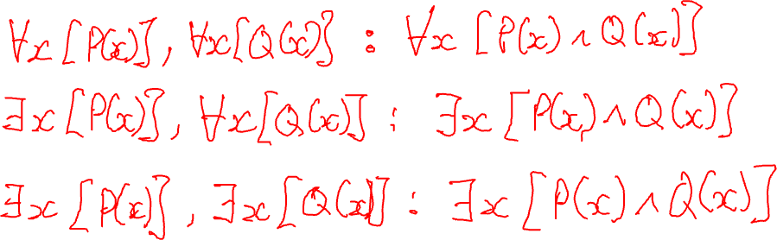
Natural Deduction
Natural Deduction is much more subtle that for propositional logic
All of the same rules apply but need to be applied with care.
Are the following arguments valid or invalid? Where is the error in reasoning?
Notes:
Write in
forall x [P(x)], forall x [Q(x)] : forall x P(x)^Q(x)
exists x [P(x)], forall x [Q(x)] : exists P(x)^Q(x)
exists x [P(x)], exists x [Q(x)] : exists P(x)^Q(x)

Slide 11
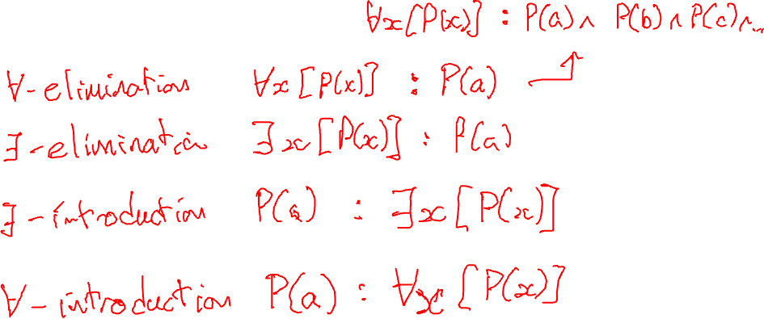
Some new rules
Notes:
### $\forall$-elimination
The basic idea here is that if a formula is universally quantified, then we can infer a particular instance
> 1. $\forall x [\phi(x)]$
> 2. $\phi(a)$
This is related to $\land$-elimination because $\forall x [\phi(x)] \equiv \phi(a) \land\phi(b)\land\phi(c)\dots$
### $\exists$-introduction
Given a particular instance we can infer an existential quantification
> 1. $\phi(a)$
> 2. $\exists x [\phi(x)]$
This is related to $\or$-introduction because $\exists x [\phi(x)] \equiv \phi(a) \lor\phi(b)\lor\phi(c)\dots$
### $\forall$-introduction
> 1. $\phi(a)$
> 2. $\forall x [\phi(x)]$
Why can we do this? If $\phi(a)$ is true for some arbitrary $a$, then, if we know nothing at all about $a$ then it must be True for all $a$. We can only do this if we know nothing else about the particular instance $a$ (ie it is not used in any of the premises of the proof).

Slide 12

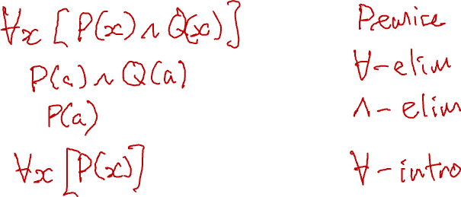
Proofs in First Order Logic
Process is somewhat different
Applying proof rules under a quantifier can be fraught with error
Typically proceed by eliminating the quantifiers, apply the rules, and then reintroduce the quantifiers
Example: $∀x\left[P\left(x\right)∧Q\left(x\right)\right] :∀x\left[P\left(x\right)\right]$
Notes:
Example 1

Slide 13

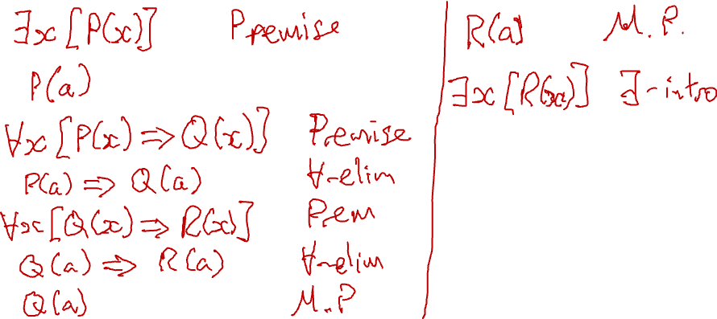
Another Proof
$$∃x\left[P\left(x\right)\right], ∀x\left[P\left(x\right)⇒Q\left(x\right)\right], ∀x\left[Q\left(x\right)⇒R\left(x\right)\right] : ∃x\left[R\left(x\right)\right]$$

Slide 14

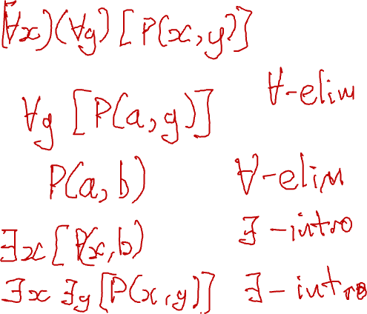
Third example
$$\left(∀x\right)\left(∀y\right)\left[P\left(x,x\right)\right] : \left(∃x\right)\left(∃y\right)\left[P\left(x,y\right)\right]$$

Slide 15
Exercise: First Order Logic

Slide 16
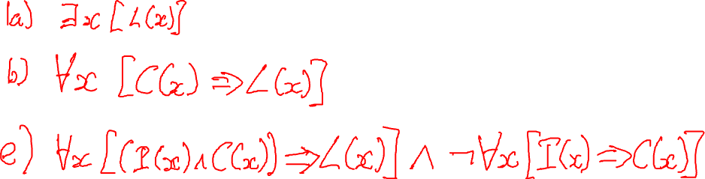

Slide 18
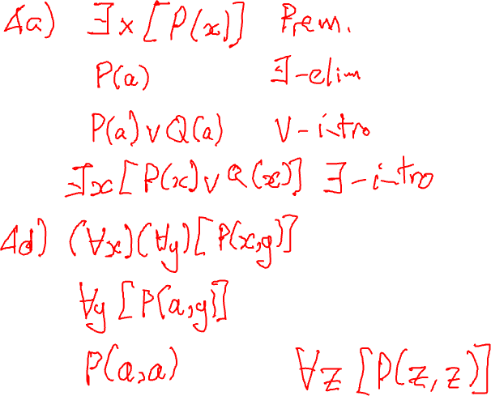

Slide 19
MSc Artificial Intelligence
Knowledge Engineering
15 November 2023
Notes:
This colour bar is to be used for Artificial Intelligence

Slide 20

In the era of LLMs do we need all this?
Large language models like Chatgpt, Llama, Bard, Claude can understand and generate astonishingly coherent natural language
Bold claims have been made about the capabilities of these systems
Do these claims stack up?
Can LLMs reason?

Slide 21
How do LLMs work?
[You will learn more about this next term in “Natural Language Processing”]
LLMs are generative language models
Trained to generate sequences of words conditioned on
A prompt supplied by us
What they have already generated
Essentially they predict the next word in a sequence by sampling from the distribution of possible words.
Why do they work so well?
Very large neural network models
Self-supervised generative pre-training – learning to predict the training data itself
Trained on vast amounts of data

Slide 22
How do LLMs work?
Why do some people think this might lead to AGI?
Massively improved ability to generate text over previous approaches
Far better at the “Turing Test” than previous efforts
Some evidence that its output is a synthesis of its training data not a regurgitation
Wishful thinking!

Slide 23
How do LLMs work?
Why do some people think this might lead to AGI?
Massively improved ability to generate text over previous approaches
Far better at the “Turing Test” than previous efforts
Some evidence that its output is a synthesis of its training data not a regurgitation
Wishful thinking!

Slide 24
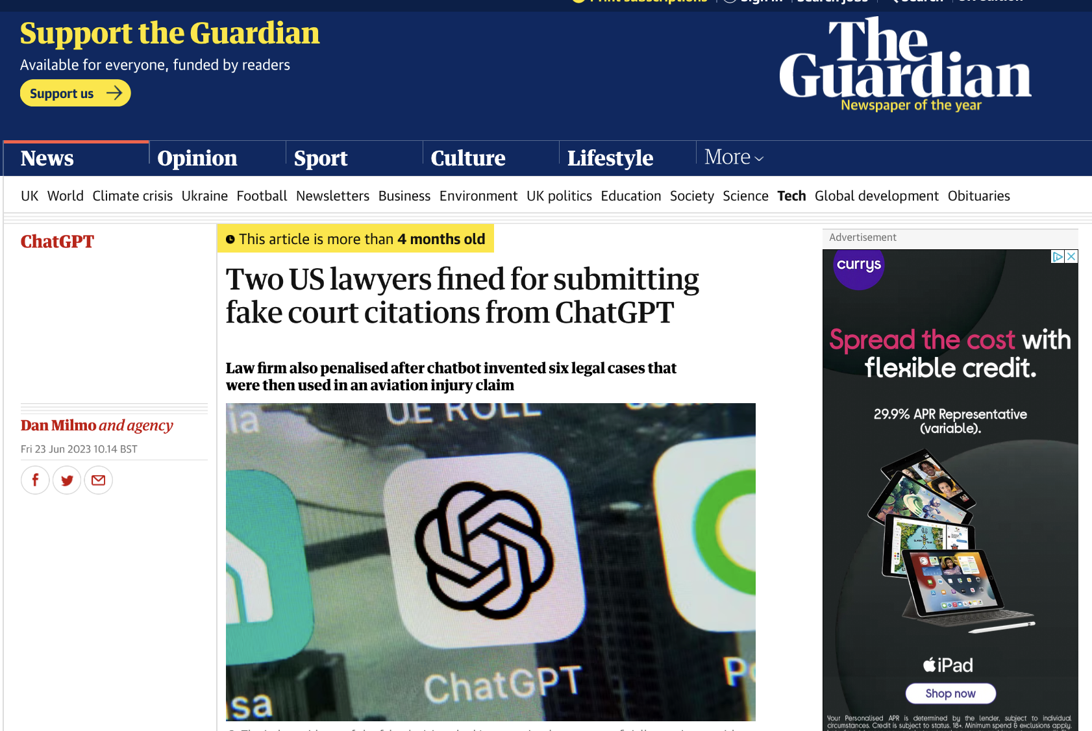
Can we trust it?

Slide 25

Leading questions?

Slide 26
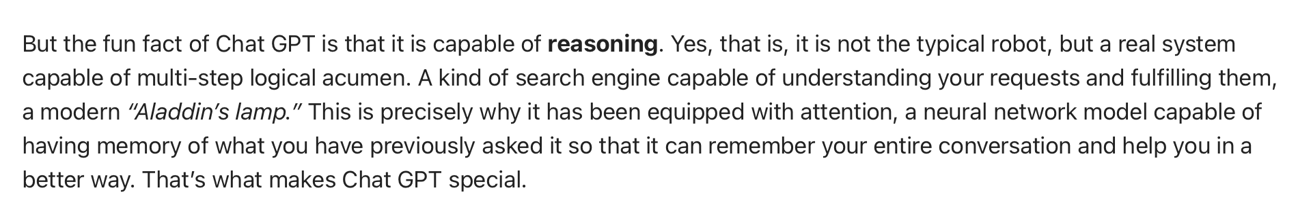
Bold Claims
Let’s find out if this is true

Slide 27
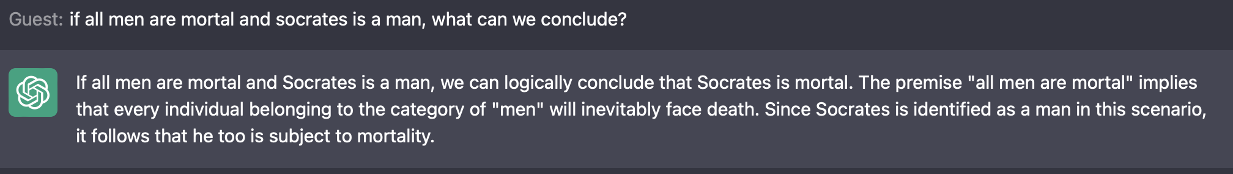
An old friend…
Can chatgpt do modus ponens?
All men are mortal
Socrates is a man…

Slide 28

More complex arguments
If I take a hat and gloves when it’s cold and I’m not wearing a hat or gloves, is it cold?

Slide 29
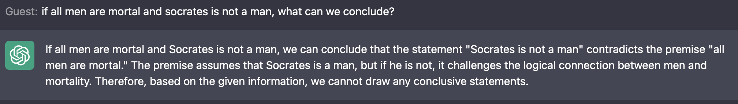
An old friend…
Can we tempt it into a logical fallacy?
All men are mortal
Socrates is not a man…

Slide 30
Exercise
Go to the exercise “Are you Logical”.
Copy and paste the first five questions (one at a time) into Chatgpt.
How does it do? Is it consistent? What sort of mistakes does it make?

Slide 31
Exercise
Go to the exercise “Elementary my dear Watson” on Monday 13 November.
Copy and paste the four parts of question 3 (one at a time) into Chatgpt. You’ll need to include the question each time.
How does it do? Is it consistent? What sort of mistakes does it make?

Slide 32
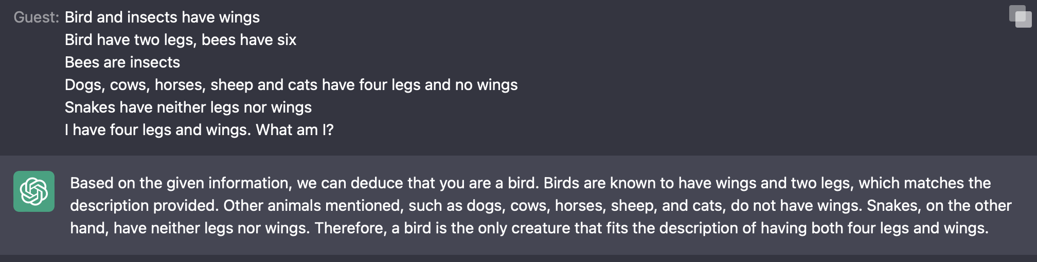
A simple riddle
Bird and insects have wings
Bird have two legs, bees have six
Bees are insects
Dogs, cows, horses, sheep and cats have four legs and no wings
Snakes have neither legs nor wings
I have four legs and wings. What am I?

Slide 33
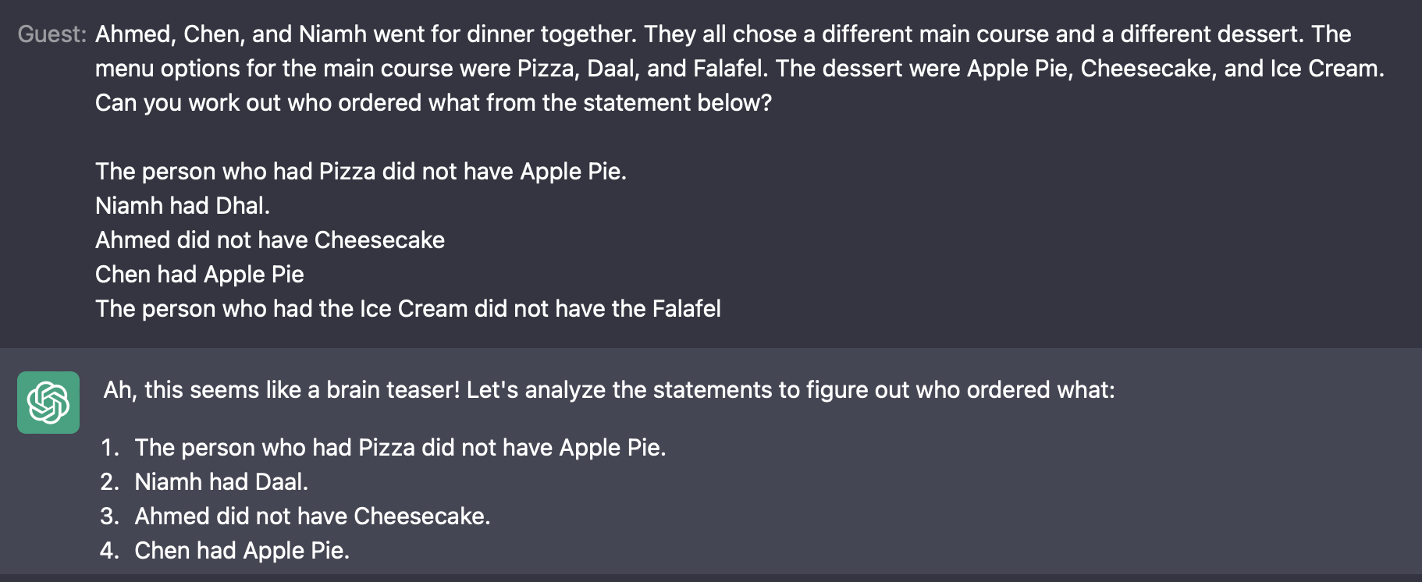
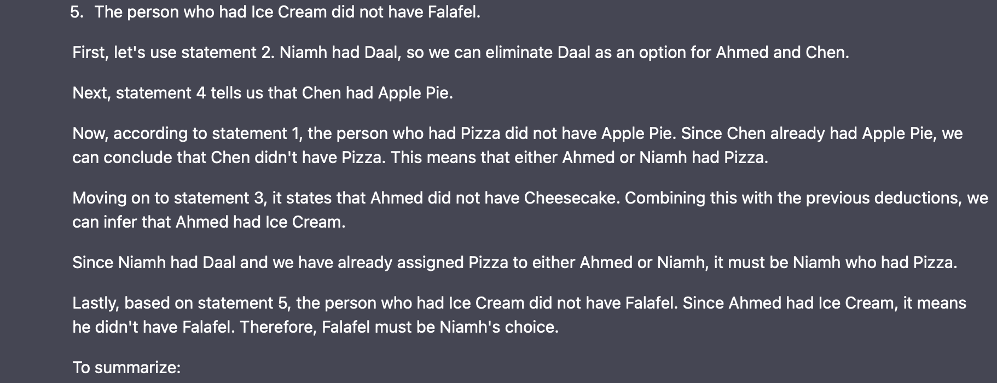


Slide 34
Challenge
Can you get ChatGPT to solve the three diners puzzle (Are you Logical, Q6)?
(You may need to edit the text to make it fit).
15-20 minutes
What sort of mistakes does it make (if it makes mistakes)?

Slide 35
Challenge
Can you get ChatGPT to solve Einstein’s Riddle (slides, Tuesday 13 November)?
(You may need to edit the text to make it fit).
15-20 minutes
What sort of mistakes does it make (if it makes mistakes)?

Slide 36
The Assignment
Now open in Canvas
Let’s take a look!

Slide 37
Day 3 Wrap-up
First Order Logic
LLMs and Reasoning
The Assessment
Next Week:
Knowledge Graphs

